Slide 1

Digital Communication
Project
Group 2

Slide 2
Median based clustering for underdetermined blind signal processing

Slide 3
Objective
Given an observed m-dimensional mixture random vector x, which allows an unknown decomposition x = As, the goal is to identify the mixing matrix A and the unknown n-dimensional source random vector s.

Slide 4
Understanding of the Problem
Blind Source Separation (BSS) is the separation of a set of source signals from a set of mixed signals, without the aid of information (or with very little information) about the source signals or the mixing process.
Underdetermined or Overcomplete BSS is the type of BSS in which the total number of mixtures is less than the total number of sources.

Slide 5
The most commonly used overcomplete algorithms rely on sparse sources , which can be identified by clustering, usually by k-means or some extension.
However, apart from the fact that mean-based clustering lacks theoretical justiﬁcations, it only identiﬁes the correct A if the data density approaches a delta distribution and hence, at times converges to the wrong solution. Also, Mean based clustering does not possess any equivariance property which suggests that performance will be independent of A.
The figure in the following slide indicates the deficiency of mean based clustering.

Slide 6
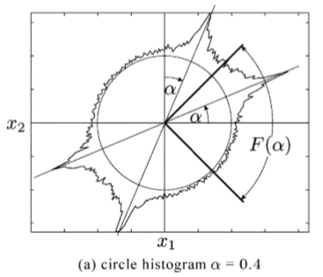
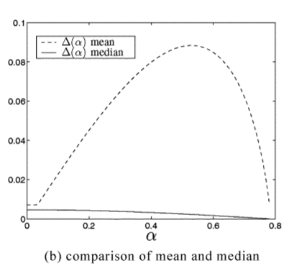
Here a mixture x of two independent gamma-distributed sources using a mixing matrix A with columns inclined by α and (π/2 - α) respectively have been considered.
Figure ‘a’ represents the mixture density for α = 0.4 after the projection onto the circle.
For α ∊ [0; π/4), we compare the error when estimating A by the mean and the median of the projected density in the receptive ﬁeld F(α) = (-π/4 π/4) of the known column a1 of A.
Figure ‘b’ clearly indicates that median-based clustering performs much better as compared to mean based clustering.

Slide 7
Blind Source Separation
x=As
where,
x = m-dimensional mixture random vector
s = n-dimensional source random vector with component density p(s)
A = mixing matrix having independent columns each of unit norm

Slide 8
B is said to be equivalent to A, B ~ A, if B can be written as:
B = APL
where -
L = An invertible diagonal matrix known as the Scaling Matrix.
P = An invertible matrix comprising of unit vectors in each row. It is also known as Permutation Matrix.
Hence, it can be assumed that the columns a_{i} of A have unit norm.

Slide 9
Blind Source Separation (BSS) follows a two step approach:
1. Geometric matrix recovery of A (Blind Mixing Model Recovery - BMMR) - Tries to identify A in x = As given x , where s is assumed to be statistically independent.
2. Blind source recovery (BSR) - Once A is estimated, BSR is used to find s.

Slide 10
Geometric Matrix recovery
For Geometric Matrix Recovery of A we assume the following:
1) Underdetermined or over-complete systems - m ≤ n (fewer mixtures than sources).
2) A has pairwise linearly independent columns.
3) The source vector s is statistically independent.

Slide 11
Independent Component Analysis
Independent component analysis (ICA) is a computational method for separating a multivariate signal into additive subcomponents. This is done by assuming that the subcomponents are non-Gaussian signals and that they are statistically independent from each other.
We have assumed to s to be statistically independent, n-dimensional, symmetric random vector with density p_{s} describing the sources.
Since, s is independent,
p_{s}(s₁, s₂, s₃, s_{n}) = p_{s1}(s₁)*p_{s2}(s₂)*p_{s3}(s₃).....p_{sn}(s_{n})
And, s is symmetric,
and p(s_{i})=p(-s_{i}). Hence making E(s) = 0.

Slide 12
Geometric Blind Mixing Model Recovery (BMMR) algorithm
Pick 2n starting vectors w₁,w₁’,w₂,w₂’,......,w_{n},w_{n}’ such that w_{i} are pairwise linearly independent and w_{i} = -w_{i}’.These wi are called Neurons.
Fix a learning rate η : N -> R
Iterate the following steps until an appropriate abort condition has been met:
Choose a sample x(t) according to the distribution of x. If x(t) = 0 , pick a new one — note that this case happens with probability zero.

Slide 13


Project x(t) onto the unit sphere, and get where where ∊ S^{m-1}.
Then set

Slide 14
Blind source recovery
An estimate of A was obtained as a result of BMMR. In order to solve the overcomplete BSS problem, we are therefore left with the task of reconstructing the sources using the mixtures and the estimated matrix(BSR).
Since A has full rank, the equation x=As yields the n-m dimensional vector space A​⁻¹​{x} as solution space for s. Hence, if n>m the source-recovery problem is ill-posed without further assumptions. An often used assumption is derived using a maximum likelihood approach.

Slide 15
The maximum-likelihood algorithm states that the probability of observing x given A and s can be written as P(x|s,A).
Using Bayes Theorem the posterior probability of S is -
P(s|x,A) = (P(x|s,A)*P(s))/P(x)(such that x=As)
For reconstructing s, we will maximize the posterior probability-
s = arg max P(s|x,A)= arg max P(x|s,A)*P(s)

Slide 16
Progress Made
Tasks Completed:
We generated two random mixtures X1 and X2 from the 3 sources S1, S2, S3.
Finding pairwise independent w_{i}, the neurons and the B(implementing the given algorithm).
Finding the error between B and A: E = || A_{u} - BM ||.

Slide 17
Plan of Action moving forward:
Use in-built mean based clustering function and compare it with the algorithm output.
Obtaining A using in-built k-medoid function.
Comparing A obtained by both the methods and computing error.
Obtaining the source S1, S2 and S3 using both the methods.

